Slide 1

Text Analytics and
Taxonomies
Tom Reamy
Chief Knowledge Architect
KAPS Group
http://www.kapsgroup.com

Slide 2

Agenda
Introduction – Semantic Context, Taxonomy Gap
Elements of Text Analytics
  Categorization, Extraction, Summarization
Taxonomy / Text Analytics Software
  Variety of Vendors / Features
  Selecting Software – Two Phase, Proof of Concept
Text Analytics and Taxonomies
  Integration of the Two and Implications
Development and Applications
  Taxonomy Skills, Sentiment Analysis and Beyond
Conclusions and Resources

Slide 3

KAPS Group: General
Knowledge Architecture Professional Services
Virtual Company: Network of consultants – 8-10
Partners – SAS, SAP, Expert Systems, Smart Logic, Concept Searching, etc.
Consulting, Strategy, Knowledge architecture audit
Services:
  Taxonomy/Text Analytics development, consulting, customization
  Technology Consulting – Search, CMS, Portals, etc.
  Evaluation of Enterprise Search, Text Analytics
  Metadata standards and implementation
  Knowledge Management: Collaboration, Expertise, e-learning
  Applied Theory – Faceted taxonomies, complexity theory, natural categories

Slide 4
Introduction- Semantic Context
Content Structure
Thesauri, Controlled Vocabulary, Glossaries, Product Catalogs
  Resources to build on
Metadata standards – Dublin Core - Mostly syntactic not semantic
  Semantic – keywords – very poor performance, no structure
  Derived metadata – from link analysis, URLs
Best Bets, Folksonomy – high level categorization-search
  Human judgments – very labor intensive
Facets – classes of metadata
  Standard - People, Organization, Document type-purpose
  Requires huge amounts of metadata

Slide 5
Introduction – Taxonomy Gap
Multiple Types of Taxonomy
  Browse – classification scheme
  Formal – Is-Child-Of, Is-Part-Of
  Large formal taxonomies - MeSH – indexing all topics
  Small informal business taxonomies
Structure for Subject Metadata
  An answer to information overload, search, findability, etc.
  Consistent nomenclature, common language
  Application platform – adding meaning
Mind the Gap
  How do I get there from here?

Slide 6
Introduction – Taxonomy Gap
Taxonomies – not an end in themselves
  (They just sit there)
Gap – between documents and taxonomy
How do you apply the taxonomy to documents?
  Tagging documents with taxonomy nodes is tough
  Library staff – too limited and expensive (Not really), experts in categorization not subject matter
  Authors – Experts in the subject matter, terrible at categorization
  Automated – only if exact match to term
Text Analytics is the answer(s)!

Slide 7
Introduction to Text Analytics
Text Analytics Features
Noun Phrase Extraction
  Catalogs with variants, rule based dynamic
  Multiple types, custom classes – entities, concepts, events
  Feeds facets
Summarization
  Customizable rules, map to different content
Fact Extraction
  Relationships of entities – people-organizations-activities
  Ontologies – triples, RDF, etc.
Sentiment Analysis
  Rules –Products and their features and phrases

Slide 8
Introduction to Text Analytics
Text Analytics Features
Auto-categorization
  Training sets – Bayesian, Vector space
  Terms – literal strings, stemming, dictionary of related terms
  Rules – simple – position in text (Title, body, url)
  Semantic Network – Predefined relationships, sets of rules
  Boolean– Full search syntax – AND, OR, NOT
  Advanced – DIST (#), SENTENCE, NOTIN, MINOC
This is the most difficult to develop, fundamental
Combine with Extraction
  If any of list of entities and other words
  Build dynamic rules with categorization capabilities - disambiguation

Slide 9
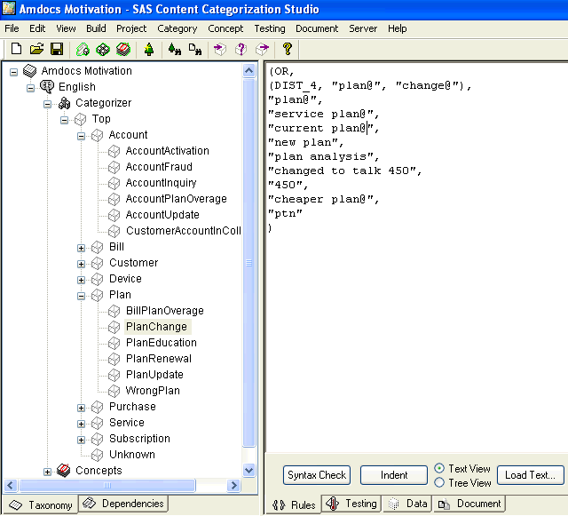

Slide 10
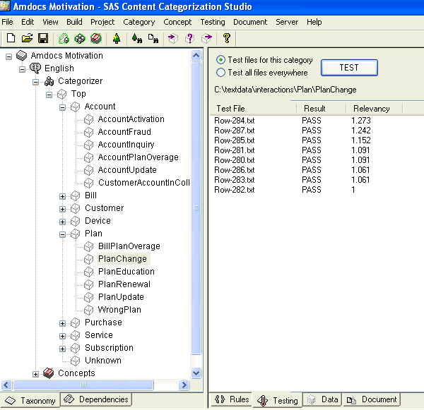

Slide 11
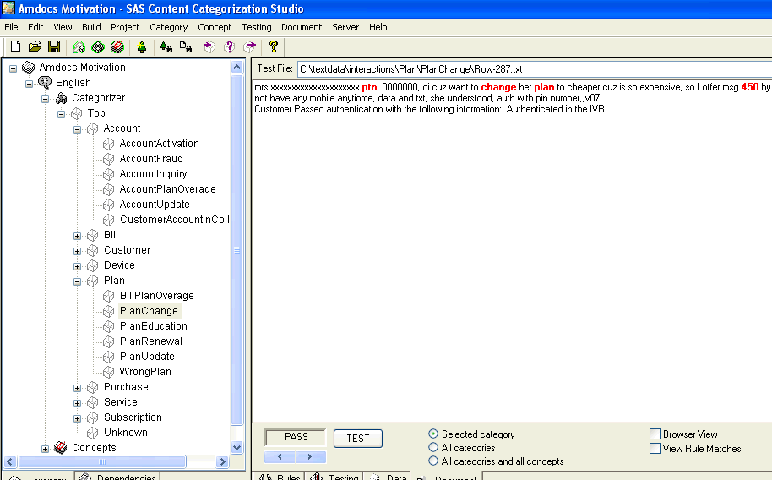

Slide 12
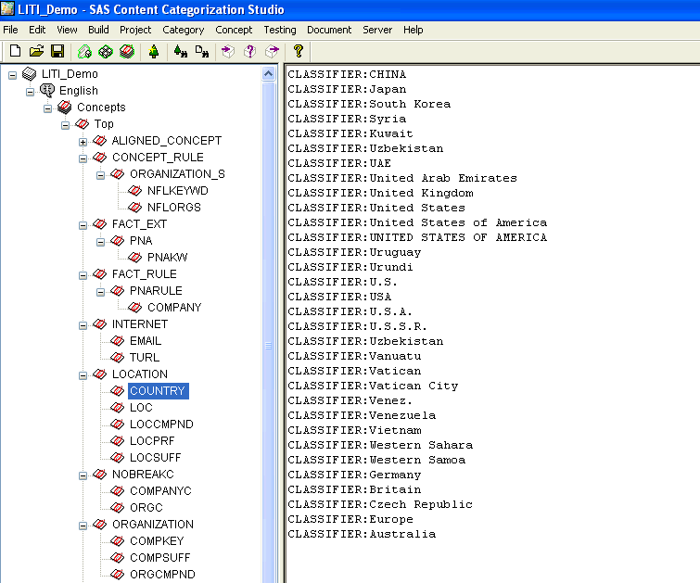

Slide 13
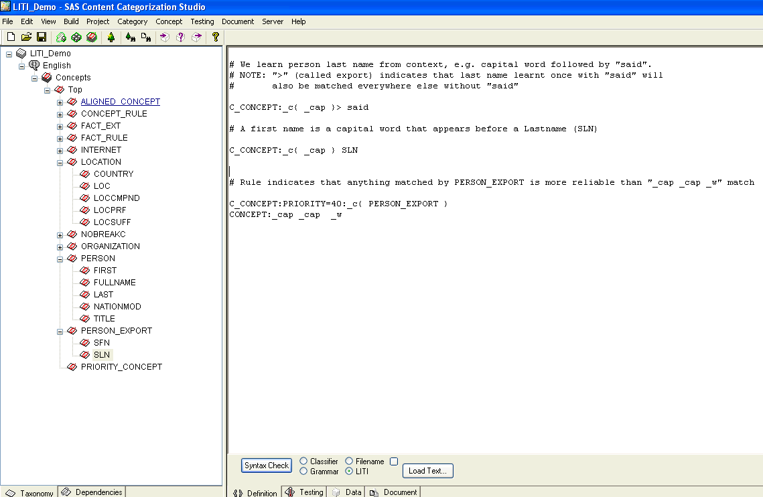

Slide 14
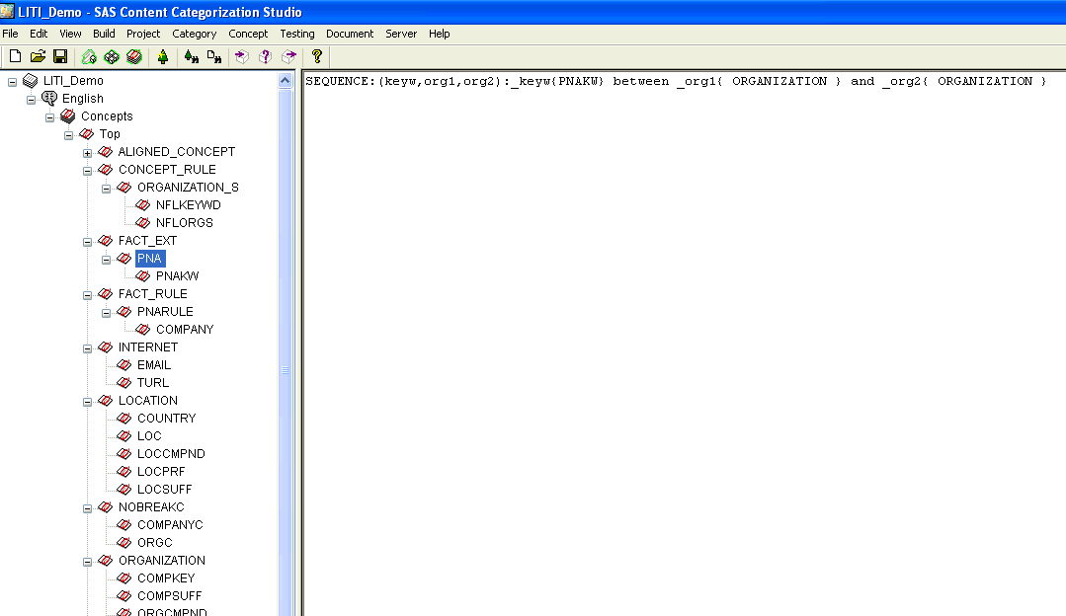

Slide 15
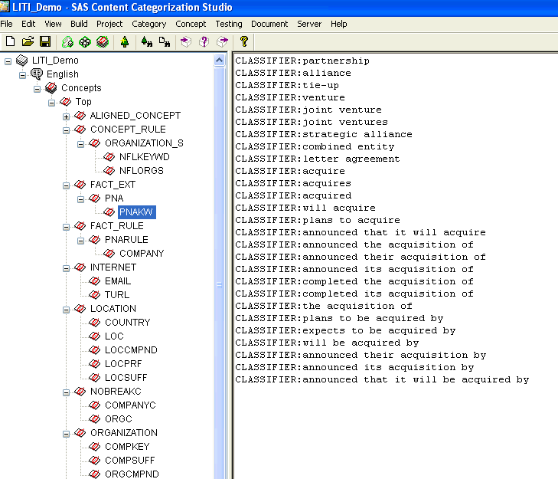

Slide 16
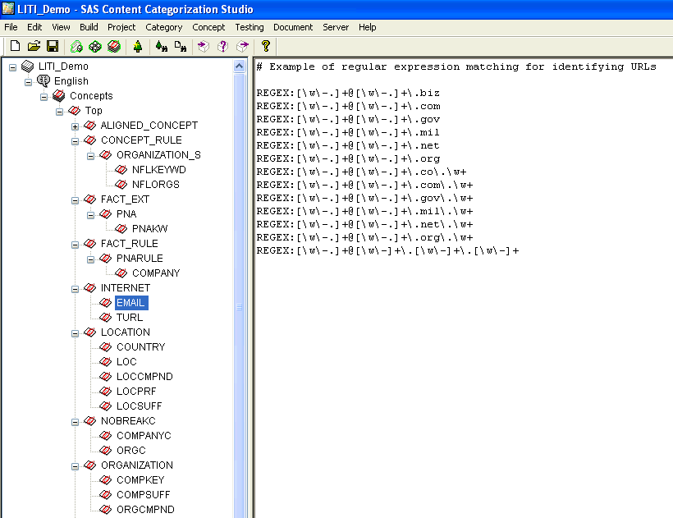

Slide 17
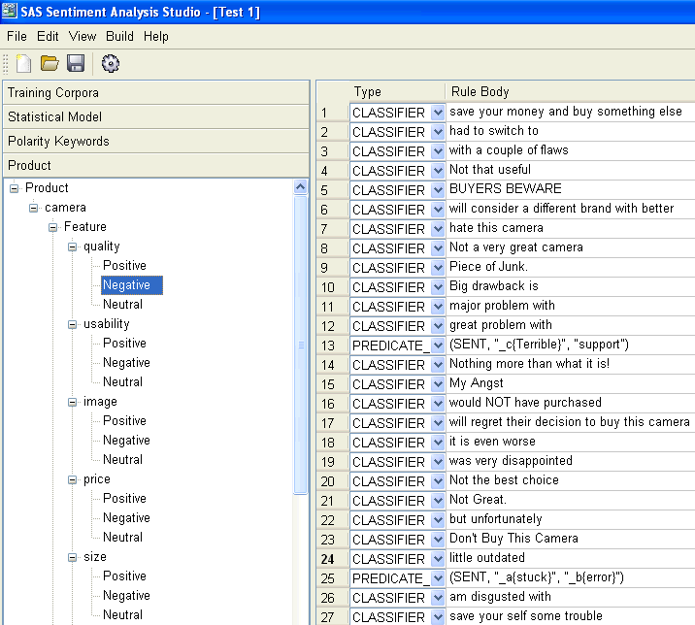

Slide 18
From Taxonomy to Text Analytics Software
Software is more important in Text Analytics
  No Spreadsheets for semantics
Taxonomy editing not as important
  Multiple contributors and/or languages an exception
No standards for Text Analytics
  Everything is custom job
What does not work
  Automatic taxonomies – clustering is exploratory tool
What sometimes works
  Automatic categorization – when no humans available

Slide 19
Varieties of Taxonomy/ Text Analytics Software
Vocabulary and Taxonomy Management
  Synaptica, Mondeca, Multi-Tes, WordMap, SchemaLogic
Taxonomy and Text Analytics Platform
  Clear Forest, Data Harmony, Concept Searching, Expert System
  SAS-Teragram, IBM, SAP-Inxight, Smart Logic, GATE-Open Source
Content Management
  Nstein, Documentum, Sharepoint, etc.
Embedded – Search
  FAST, Autonomy, Endeca, Exalead, etc.
Specialty
  Sentiment Analysis – Lexalytics, Attensity, Clarabridge

Slide 20
Evaluating Text Analytics Software – Process
Start with Self Knowledge
  Why and What of software, not social media bandwagon
Eliminate the unfit
  Filter One- Ask Experts - reputation, research – Gartner, etc.
    Market strength of vendor, platforms, etc.
    Feature scorecard – minimum, must have, filter to top 3
  Filter Two – Technology Filter – match to your overall scope and capabilities – Filter not a focus
  Filter Three – In-Depth Demo – 3-6 vendors
Deep POC (2) – advanced, integration, semantics
Focus on working relationship with vendor.
Interdisciplinary Team – IT, Business, Library

Slide 21
Text Analytics and Taxonomy
Complimentary Information Platform
Taxonomy provides the basic structure for categorization
  And candidates terms
Taxonomy provides a content agnostic structure
  Text Analytics is content (and context) sensitive
Taxonomy provides a consistent and common vocabulary
Text Analytics provides a consistent tagging
  Human indexing is subject to inter and intra individual variation
Text Analytics jumps the Gap – semi-automated application to apply the taxonomy

Slide 22
Text Analytics and Taxonomy
Taxonomy andText Analytics
Standard Taxonomies = starter categorization rules
  Example – Mesh – bottom 5 layers are terms
Categorization taxonomy structure
  Tradeoff of depth and complexity of rules
  Easier to maintain taxonomy, but need to refine rules
  Multiple avenues – facets, terms, rules, etc.
Smaller modular taxonomies
  More flexible relationships – not just Is-A-Kind/Child-Of
  Can integrate with ontologies better – flexible, real world relationships
Different kinds of taxonomies
  Sentiment – products and features
    Taxonomy of Sentiment, Emotion - Expertise – process

Slide 23
Taxonomy in Text Analytics Development
Starter Taxonomy
  If no taxonomy, develop initial high level
Analysis of taxonomy – suitable for categorization
  Structure – not too flat, not too large
  Orthogonal categories
  Software analysis of Content - Clusters
Content Selection
  Map of all anticipated content
  Selection of training sets – if possible
  Automated selection of training sets – taxonomy nodes as first categorization rules – apply and get content

Slide 24
Text Analytics in Taxonomy Development
Case Study – Computer Science Taxonomy
Problem – 250,000 new uncategorized documents
Old taxonomy –need one that reflects change in corpus
Text mining, entity extraction, categorization
Content – 250,000 large documents, search logs, etc.
Bottom Up- terms in documents – frequency, date, source, etc.
Clustering – suggested categories, chunking for editors
Entity Extraction – people, organizations, Programming languages
Time savings – only feasible way to scan documents
Quality – important terms, co-occurring terms

Slide 25
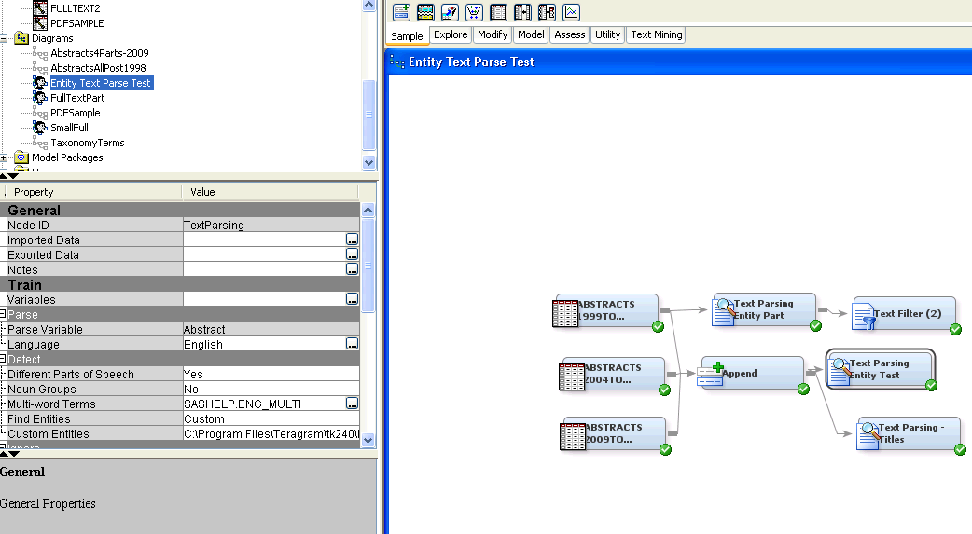
Case Study – Taxonomy Development

Slide 26
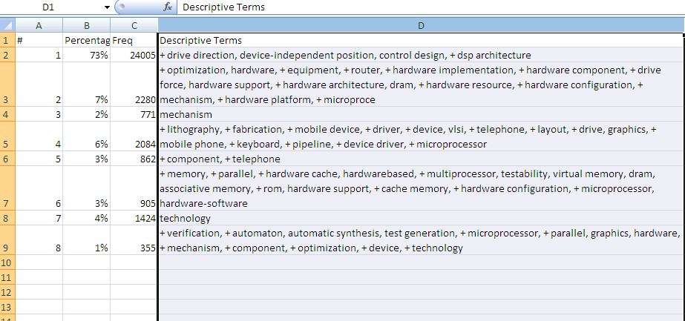
Case Study – Taxonomy Development

Slide 27
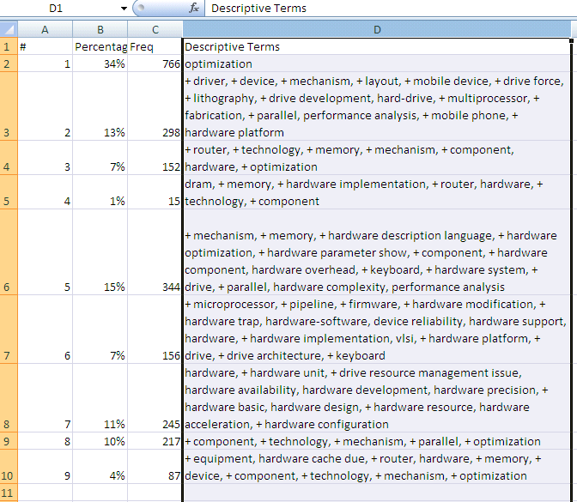
Case Study – Taxonomy Development

Slide 28
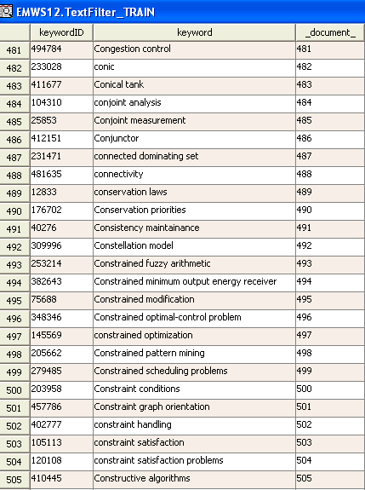
Text Analytics Development

Slide 29
Text Analytics and Taxonomy: Applications
Content Management
CM – strong on management, weak on content – black box
Authors and Metadata tags – the weak link
Hybrid Model
  Publish Document -> Text Analytics analysis -> suggestions for categorization, entities, metadata - > present to author
  Cognitive task is simple -> react to a suggestion instead of select from head or a complex taxonomy
  Feedback – if author overrides -> suggestion for new category
  Facets – Requires a lot of Metadata - Entity Extraction feeds facets

Slide 30
Text Analytics and Taxonomy: Applications
Integrated Search
Facets, Taxonomies, Text Analytics, People
Entity extraction – feeds facets, signatures, ontologies
Taxonomy & Auto-categorization – aboutness, subject
People – tagging, evaluating tags, fine tune rules and taxonomy
The future is the combination of simple facets with rich taxonomies with complex semantics / ontologies

Slide 31
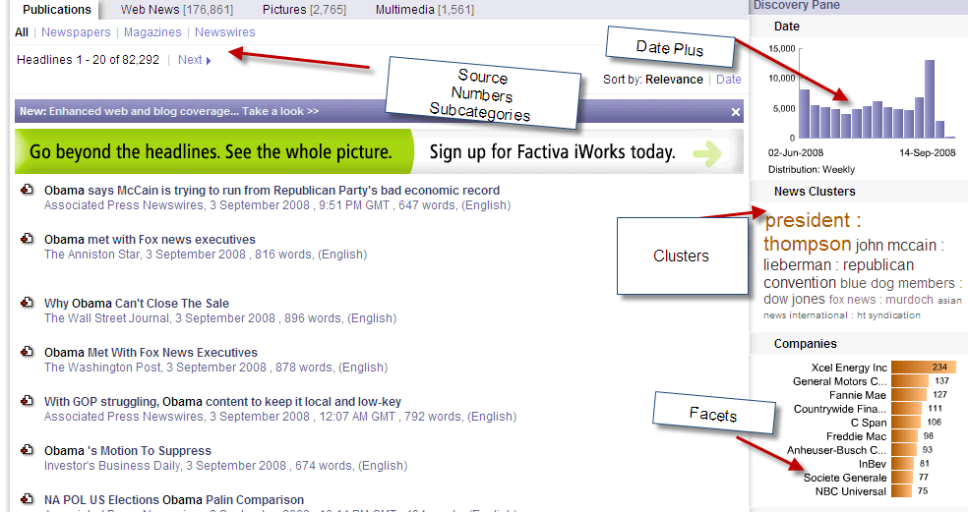

Slide 32
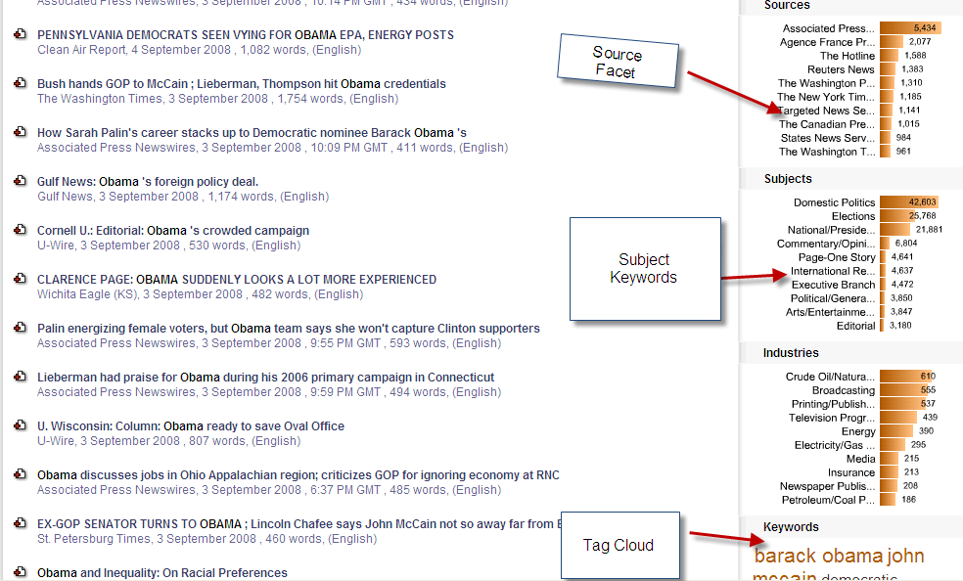

Slide 33
Taxonomy and Text Analytics
Multiple Search Based Applications
Platform for Information Applications
  Content Aggregation
  Duplicate Documents – save millions!
  Text Mining – BI, CI – sentiment analysis
  Combine with Data Mining – disease symptoms, new
    Predictive Analytics
  Social – Hybrid folksonomy / taxonomy / auto-metadata
  Social – expertise, categorize tweets and blogs, reputation
  Ontology – travel assistant – SIRI
Use your Imagination!

Slide 34
Taxonomy and Text Analytics
New Advanced Applications - Expertise Analysis
Sentiment Analysis to Expertise Analysis(KnowHow)
  Know How, skills, “tacit” knowledge
Experts write and think differently
Basic level is lower, more specific
  Levels: Superordinate – Basic – Subordinate
    Mammal – Dog – Golden Retriever
  Furniture – chair – kitchen chair
Experts organize information around processes, not subjects
Build expertise categorization rules

Slide 35
Taxonomy and Text Analytics
New Advanced Applications - Expertise Analysis
Taxonomy / Ontology development /design – audience focus
  Card sorting – non-experts use superficial similarities
Business & Customer intelligence – add expertise to sentiment
  Deeper research into communities, customers
Text Mining - Expertise characterization of writer, corpus
eCommerce – Organization/Presentation of information – expert, novice
Expertise location- Generate automatic expertise characterization based on documents
Experiments - Pronoun Analysis – personality types
  Essay Evaluation Software - Apply to expertise characterization
    Model levels of chunking, procedure words over content

Slide 36
Taxonomy and Text Analytics
New Advanced Applications - Behavior Prediction
Case Study – Telecom Customer Service
Problem – distinguish customers likely to cancel from mere threats
Analyze customer support notes
General issues – creative spelling, second hand reports
Develop categorization rules
  First – distinguish cancellation calls – not simple
  Second - distinguish cancel what – one line or all
  Third – distinguish real threats

Slide 37
Taxonomy and Text Analytics
New Advanced Applications - Behavior Prediction
Basic Rule
  (START_20, (AND,
  (DIST_7,"[cancel]", "[cancel-what-cust]"),
  (NOT,(DIST_10, "[cancel]", (OR, "[one-line]", "[restore]", “[if]”)))))
Examples:
  customer called to say he will cancell his account if the does not stop receiving a call from the ad agency.
  cci and is upset that he has the asl charge and wants it off or her is going to cancel his act
  ask about the contract expiration date as she wanted to cxl teh acct
Combine sophisticated rules with sentiment statistical training and Predictive Analytics

Slide 38
Taxonomy and Text Analytics:
Conclusions
Text Analytics can fulfill the promise of taxonomy and metadata
Content Management
  Hybrid model of tagging – Software and Human
Search – metadata driven
  Faceted navigation and Search Based Applications
Future Directions - Advanced Applications
  Embedded Applications, Semantic Web + Unstructured Content
  Expertise Analysis, Behavior Prediction (Predictive Analytics)
  Taxonomy/Ontology Development
  Social Media, Voice of the Customer, Big Data
  Turning unstructured content into data – new worlds
More Cognitive Science / Linguistics – Less Library Science

Slide 39
Questions?
Tom Reamy
tomr@kapsgroup.com
KAPS Group
Knowledge Architecture Professional Services
http://www.kapsgroup.com

Slide 40
Resources
Books
  Women, Fire, and Dangerous Things
    George Lakoff
  Knowledge, Concepts, and Categories
    Koen Lamberts and David Shanks
  Formal Approaches in Categorization
    Ed. Emmanuel Pothos and Andy Wills
  The Mind
    Ed John Brockman
    Good introduction to a variety of cognitive science theories, issues, and new ideas
  Any cognitive science book written after 2009

Slide 41
Resources
Conferences – Web Sites
  Text Analytics World
  http://www.textanalyticsworld.com
  Text Analytics Summit
  http://www.textanalyticsnews.com
  Semtech
  http://www.semanticweb.com

Slide 42
Resources
Blogs
  SAS- http://blogs.sas.com/text-mining/
Web Sites
  Taxonomy Community of Practice: http://finance.groups.yahoo.com/group/TaxoCoP/
  LindedIn – Text Analytics Summit Group
  http://www.LinkedIn.com
  Whitepaper – CM and Text Analytics - http://www.textanalyticsnews.com/usa/contentmanagementmeetstextanalytics.pdf
  Whitepaper – Enterprise Content Categorization strategy and development – http://www.kapsgroup.com

Slide 43
Resources
Articles
  Malt, B. C. 1995. Category coherence in cross-cultural perspective. Cognitive Psychology 29, 85-148
  Rifkin, A. 1985. Evidence for a basic level in event taxonomies. Memory & Cognition 13, 538-56
  Shaver, P., J. Schwarz, D. Kirson, D. O’Conner 1987. Emotion Knowledge: further explorations of prototype approach. Journal of Personality and Social Psychology 52, 1061-1086
  Tanaka, J. W. & M. E. Taylor 1991. Object categories and expertise: is the basic level in the eye of the beholder? Cognitive Psychology 23, 457-82

